Slide 1
PsychoPy: An Introduction
Dave Jangraw
12/05/19

Slide 2
Outline
Why
PsychoPy vs. E-Prime
What
Installing PsychoPy
The builder
The coder
How
How to make online experiments with Pavlovia
How to get subjects on Amazon Mechanical Turk
Where
My PsychoPyParadigms GitHub repo
My Pavlovia repos
Where to get help

Slide 3
WHY PSYCHOPY?

Slide 4
PsychoPy vs. E-Prime
Pros of PsychoPy:
It’s free!
No license keys.
Works on Macs & Linux machines as well as PCs.
A lot more flexibility and control – all of Python is at your fingertips!
Much easier to Google for help.
Can run experiments online.
No parameters hidden in sub-tabs & menus (when using coder) – easier to search.
All keypresses are logged – no lost data.
Python is much more user-friendly than E-Basic.
“Modules” can be shared across experiments.
Easier to undo.
Easier to revert back to old versions with Time Machine & GitHub.
Editor crashes less (in my experience).
Open-source and lighter weight.

Slide 5
PsychoPy vs. E-Prime
Cons of PsychoPy:
Existing experience & knowledge with E-Prime must be rebuilt.
User interface is clunkier.
More scripting means less WYSIWYG (what you see is what you get).
Audio and video drivers are sometimes a pain on new machines.
Error messages are often cryptic
No high-speed automatic testing.
No paid support team.
Less widely used.

Slide 6
PsychoPy > E-Prime in a 2011 experiment at Nottingham
After 1 semester of instruction on either PsychoPy or E-Prime, students were asked:
How did the PsychoPy software compare to E-Prime?
Notes:
The class of 2010-2011 in Psychology First Year Practicals (C81MST) at University of Nottingham were given one semester learning about how to conduct experiments using PsychoPy and another about how to run experiments using E-Prime.
These are the results of an anonymous online survey that the students filled out (N=60). The take home message seems to be that the students liked the software, indeed more than E-Prime on average, but that it still has room for improvement.

Slide 7
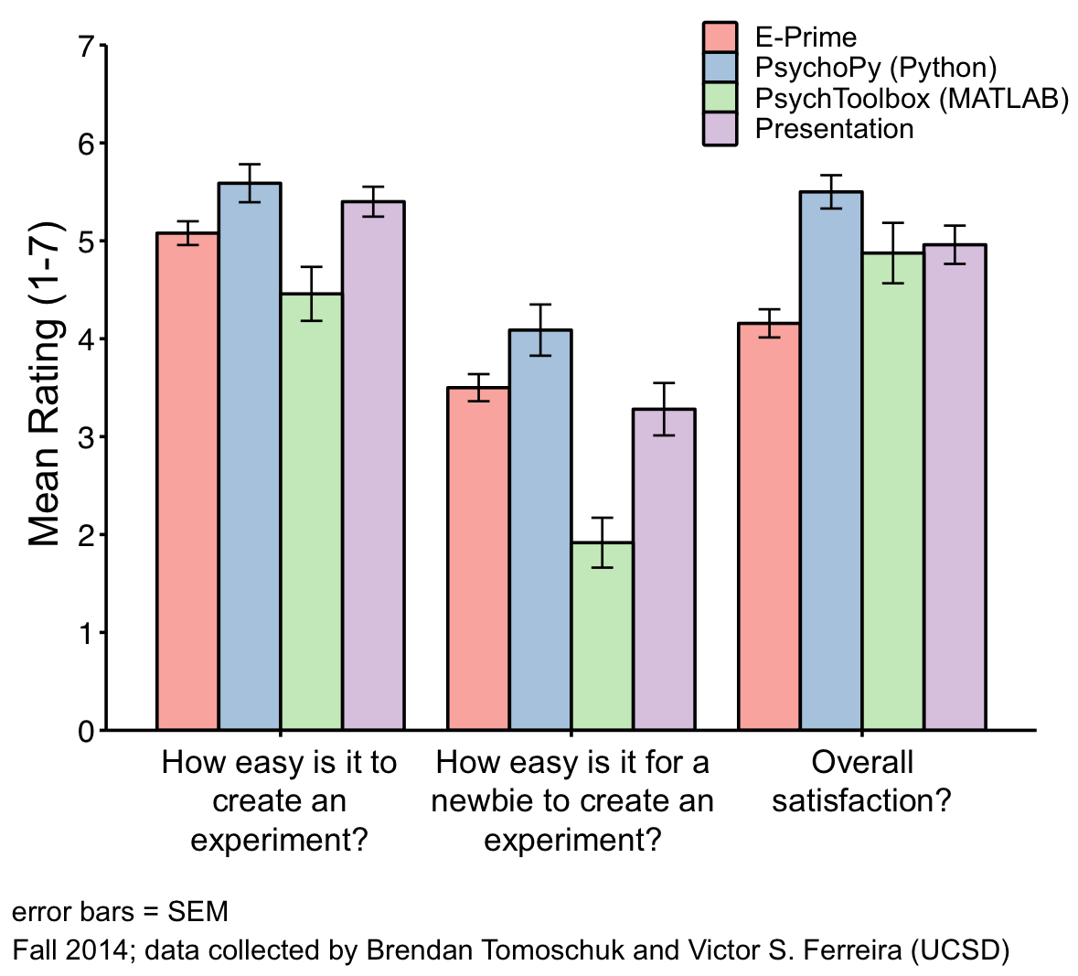
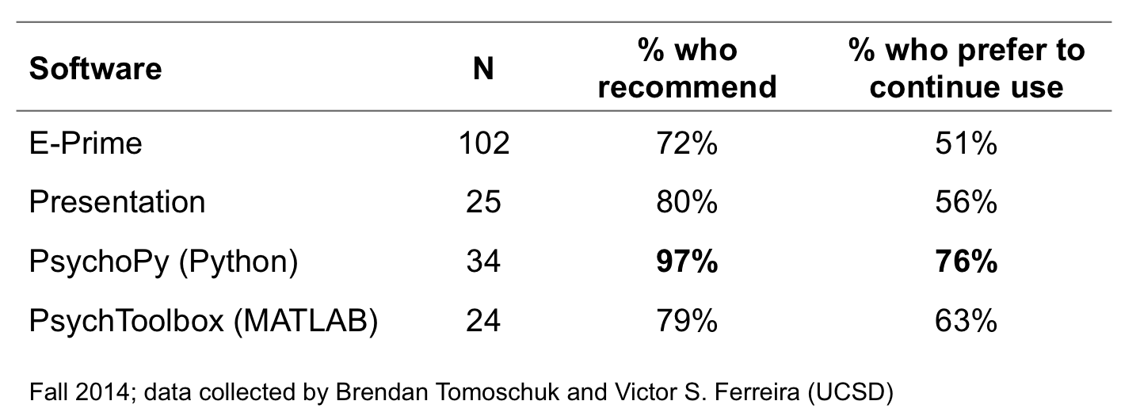
PsychoPy > E-Prime in a 2014 UCSD survey (summary from StackExchange):
I highly recommend PsychoPy over E-prime. Why?
Keeping track of who has the e-prime dongle is annoying.
Students learn it more easily (see data below).
E-prime uses visual basic (boo) and PsychoPy uses Python (yay!).
PsychoPy easily integrates with R, matlab, and HTML.
Everyone is doing it... (see data).
Some folks at UCSD did a survey in summer/fall 2014 asking researchers for their opinions. Here is a summary of the findings.

Slide 8
Why it’s good for my branch specifically:
Fits our quirks:
The branch employs a task developer, and developers will prefer Python
Allows transition to Linux machine for safe connection to database
We share multiple E-Prime keys, complicating current license-key logistics
Fellows can learn more transferrable programming skills
Long-term payoffs for fellows:
Learn programming, specifically Python
Take control of your experiment and output logs
Python can be used for analysis too
Save money and license-key-logistics for your lab
Be part of the growing open-source community

Slide 9
WHAT IS PSYCHOPY LIKE?

Slide 10
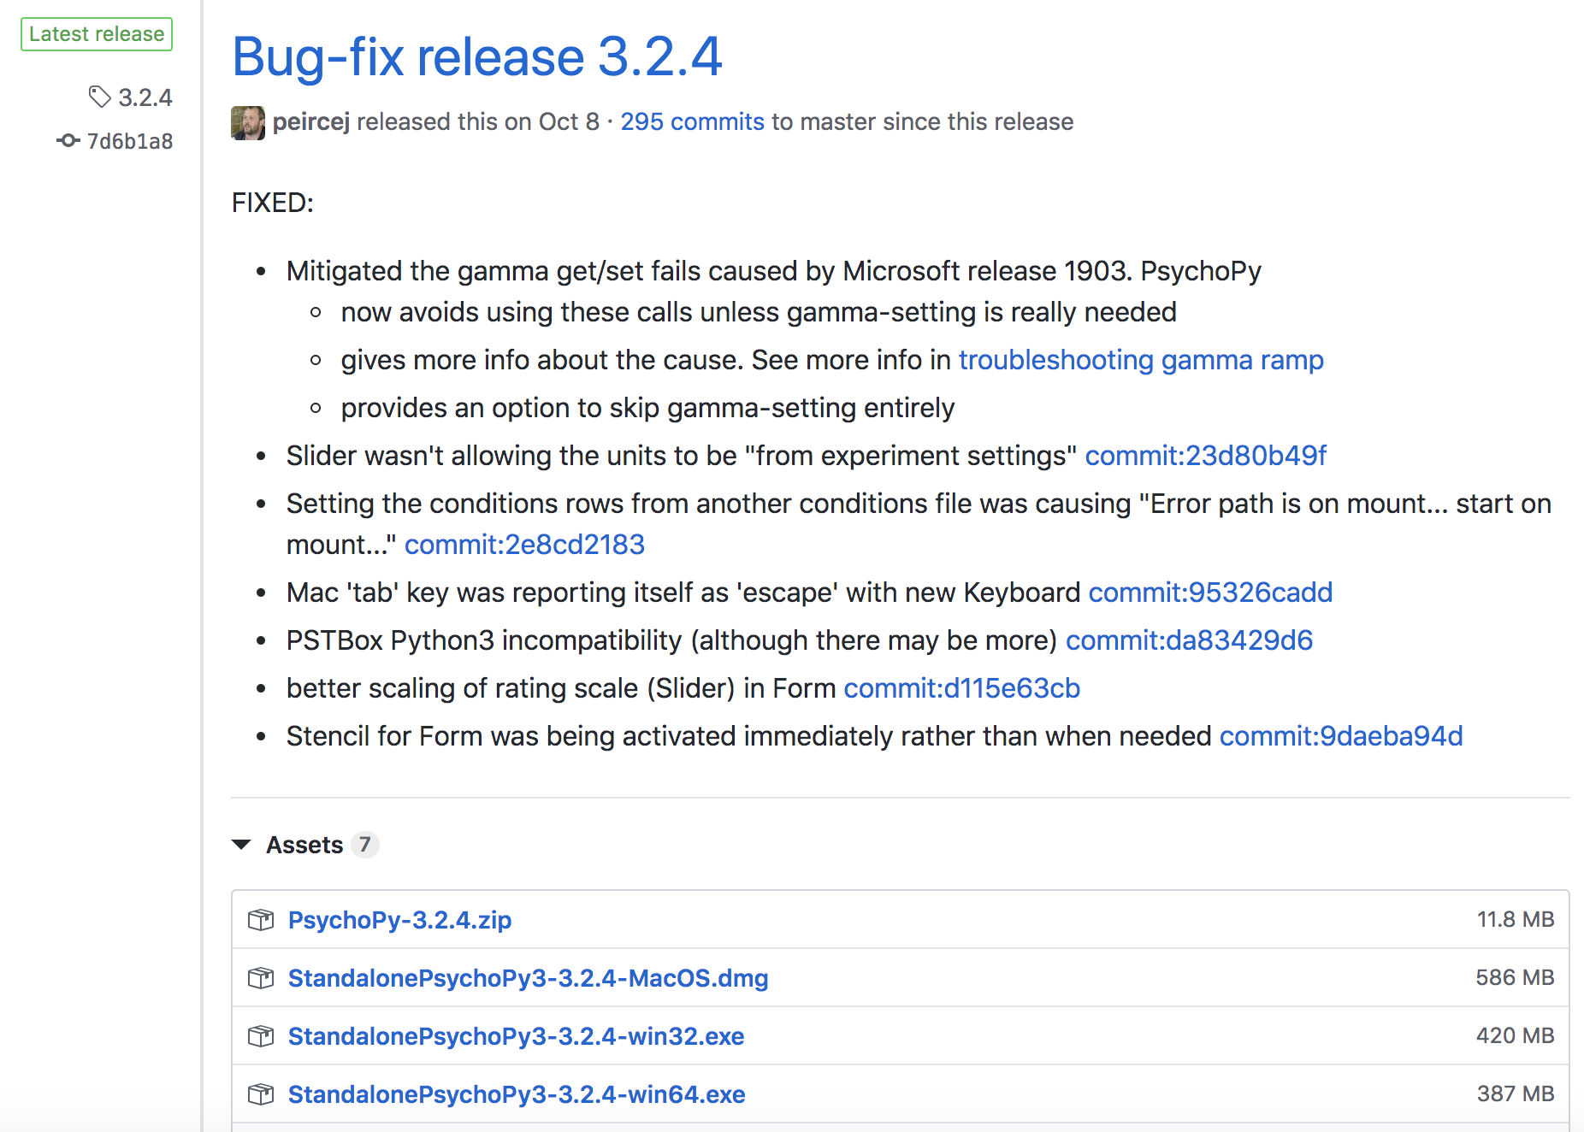
Installing PsychoPy on Your Machine
Get latest version of PsychoPy: https://github.com/psychopy/psychopy/releases/
Choose “Standalone” installer for your OS
May require admin privileges
Open and follow the instructions!

Slide 11
The PsychoPy Builder
Add new
elements
Elements of the current part
Of the experiment
Your experiment’s structure

Slide 12
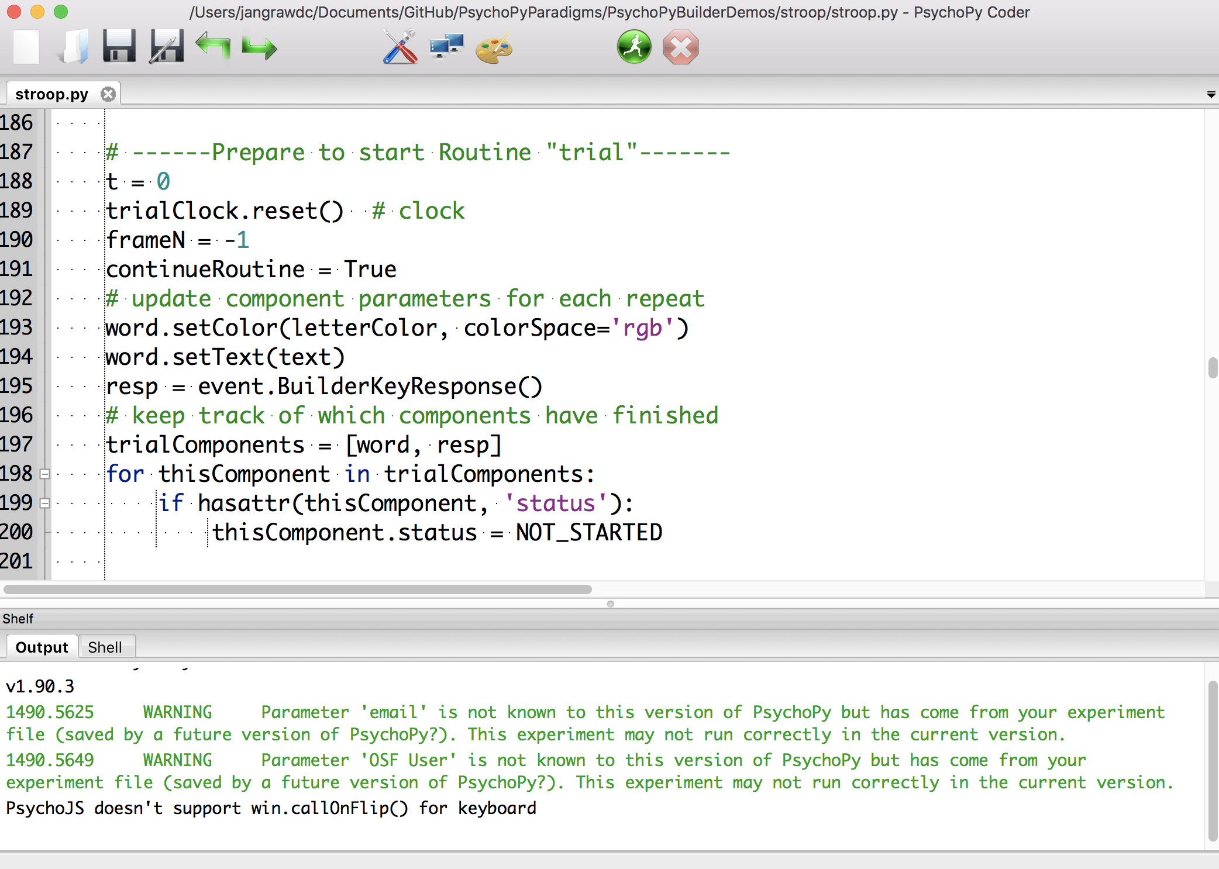
The PsychoPy Coder
All the code for
your experiment
“print” msgs & errors
from the latest run

Slide 13

Running a PsychoPy Experiment
If nothing has changed in the experiment:
.pyc = compiled code. If PsychoPy is the only python distribution on your computer, just open it!
If that doesn’t work, open the experiment in PsychoPy and click Run.
If something has changed:
Open the experiment in PsychoPy, save your changes, and click Run.
This will compile the code automatically, changing the .pyc file. Once you’re satisfied with the new version, make sure this is the .pyc that future data collecters know to use.
To End Early:
Try Escape, Cmd+. or Ctrl+.
If that doesn’t work, use ctrl-alt-del (PC) or cmd-opt-esc (mac) to force quit.

Slide 14
Handling PsychoPy data
Standard Builder Output (.csv file):
text | letterColor | corrAns | congruent | trials.thisRepN | trials.thisTrialN | trials.thisN | trials.thisIndex | resp.keys | resp.corr | resp.rt | date | frameRate | expName | session | participant
green | green | down | 1 | 0 | 0 | 0 | 2 | down | 1 | 0.770008087 | 2018_Oct_10_1425 | 60.10883008 | stroop | 1 | 1
blue | red | left | 0 | 0 | 1 | 1 | 5 | right | 0 | 0.58455801 | 2018_Oct_10_1425 | 60.10883008 | stroop | 1 | 1
green | blue | right | 0 | 0 | 2 | 2 | 3 | down | 0 | 0.83436799 | 2018_Oct_10_1425 | 60.10883008 | stroop | 1 | 1
Custom Log Output (text file):
113.1881 EXP ---START EXPERIMENT---
113.2269 EXP topMsg: text = 'Experimenter, is the scanner prepared?'
113.2269 EXP bottomMsg: text = "(Press 'Y' when it is.)"
113.2269 EXP Display WaitingForPrep
118.8992 DATA Keypress: y
118.9431 EXP topMsg: text = 'Waiting for scanner to start...'
118.9431 EXP bottomMsg: text = "(Press '5' to override.)"
118.9431 EXP Display WaitingForScanner
122.6388 DATA Keypress: 5

Slide 15
HOW CAN I RUN EXPERIMENTS ONLINE?

Slide 16
Meet Amazon Mechanical Turk (MTurk)
Named after an 18th-century chess-playing “robot” that really just had a human chess player inside.
Requesters can ask people to complete “Human Intelligence Tasks” (HITs) for a set amount of money
Usually small, easy tasks that pay a few cents
Recently, experimenters have used this same setup to collect psychology data from many subjects at once online

Slide 17
Why MTurk?
Rapid prototyping and piloting
Large baselining datasets on the cheap
Collect dozens of subjects in a single day
Not as skewed a population as you might think (McDuffie, 2019):
“Overall, the sample collected from MTurk is likely to be more diverse than a sample of undergraduate students (Buhrmester et al., 2011). Participants are generally older, more geographically representative of the US, and more diverse than participants collected from undergraduate samples.”
“Users of MTurk have some fundamental differences from the general population. MTurk workers are more educated, less religious, and more likely to be unemployed than the general population (Goodman, Cryder, & Cheema, 2013).”

Slide 18
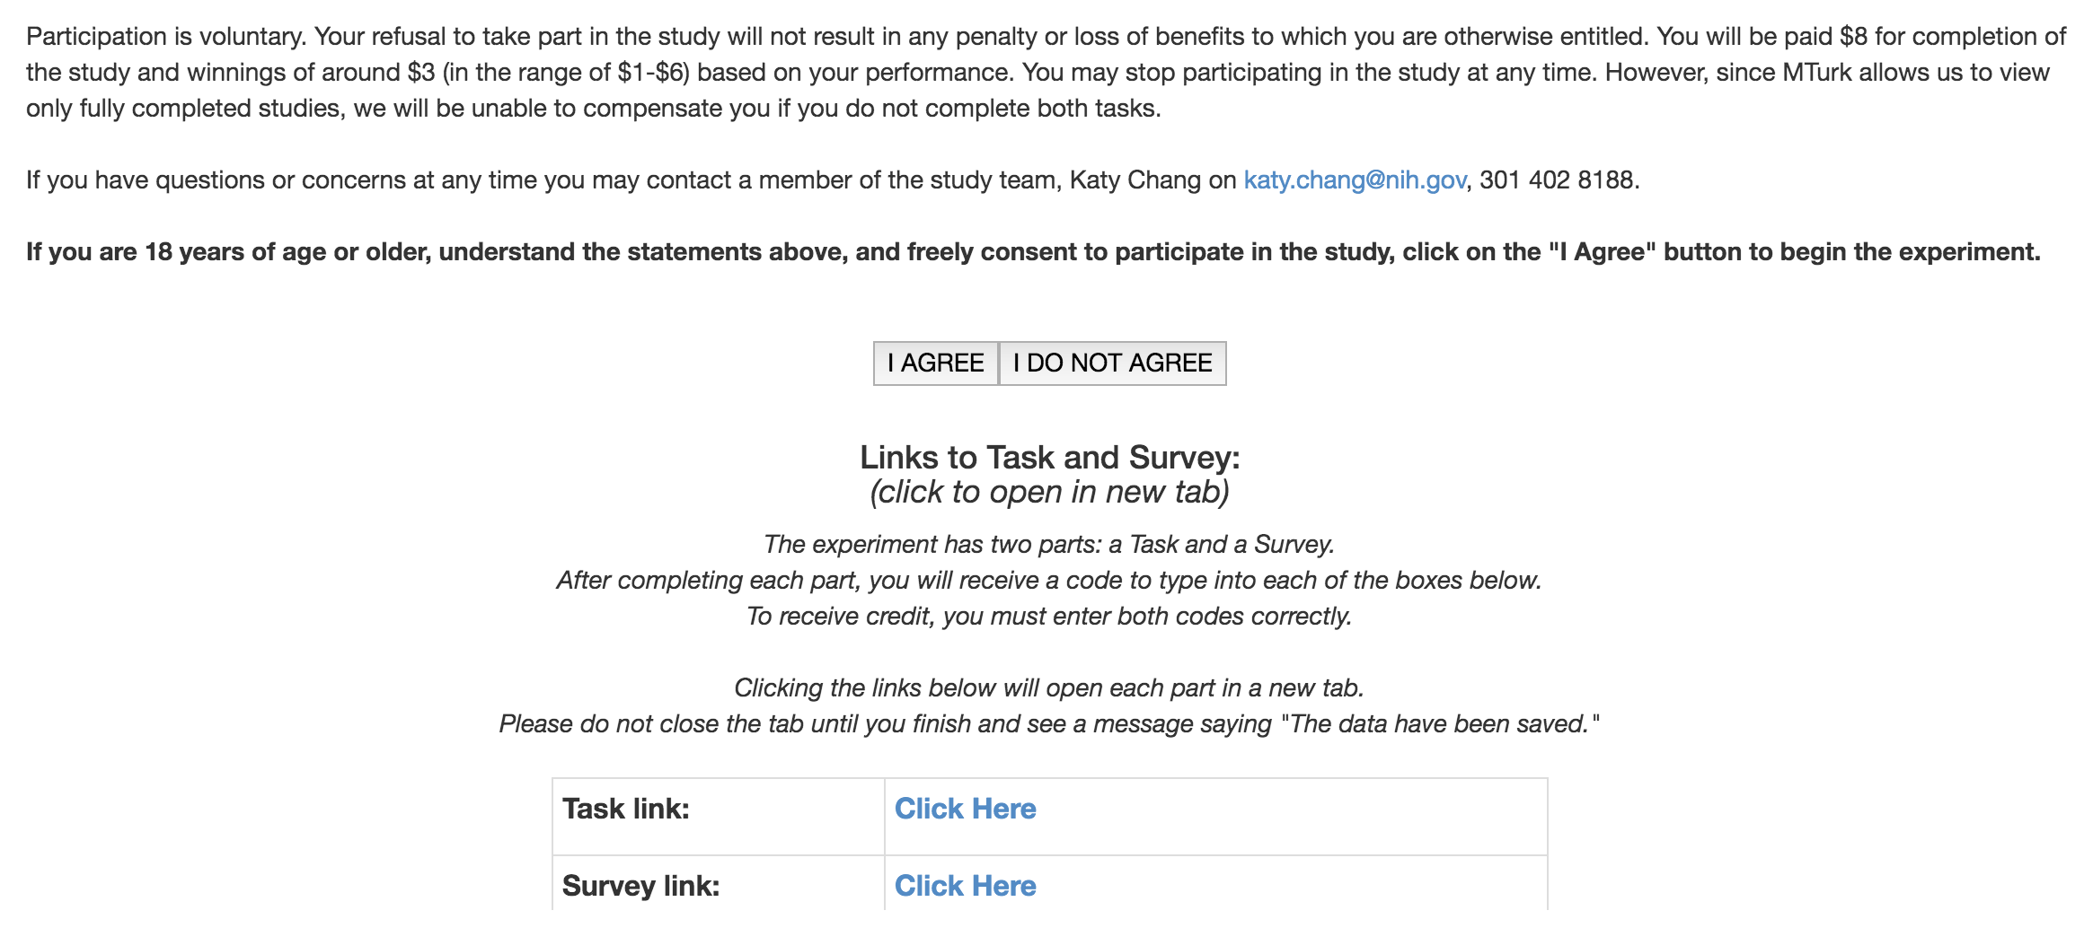
What Subjects See
Link to task

Slide 19
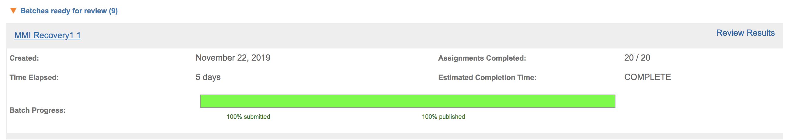
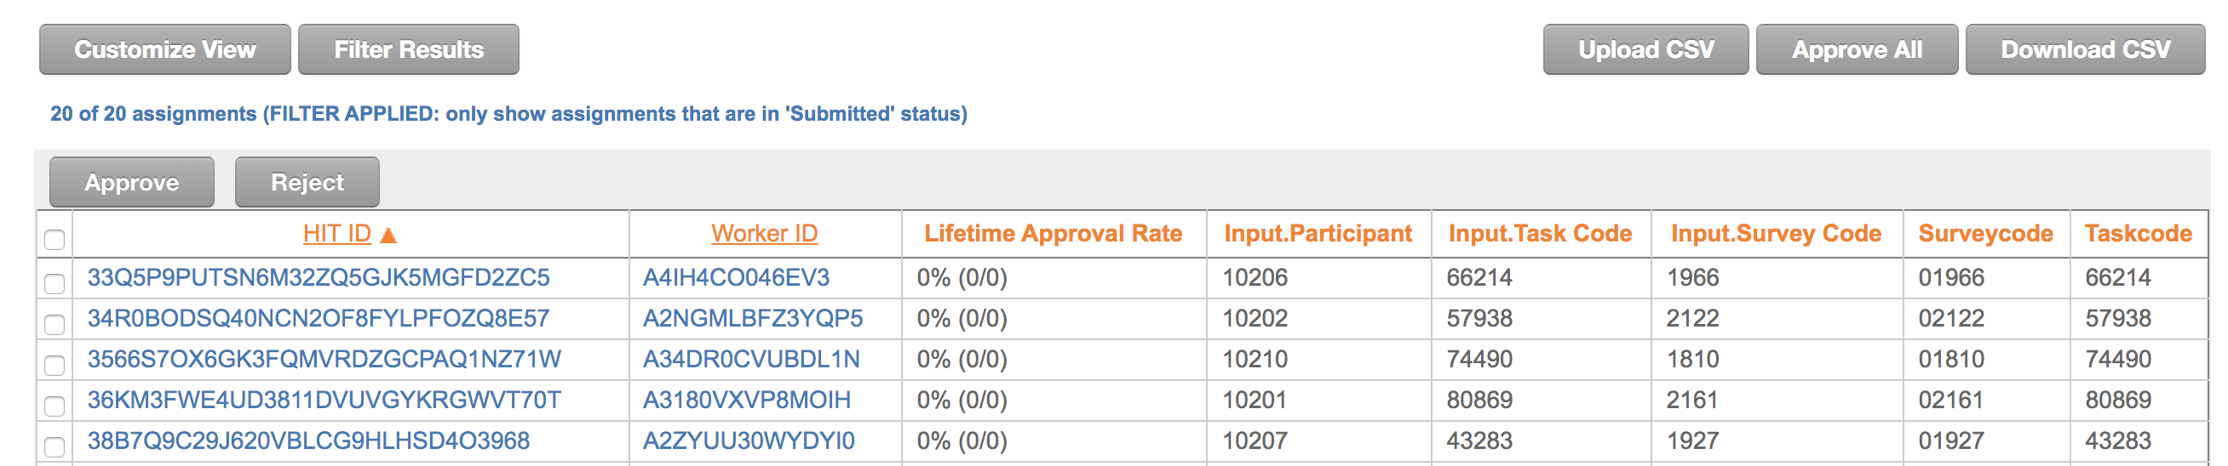
What Requesters See
Link to dashboard

Slide 20
Getting your PsychoPy Task to Work Online
Make it in the PsychoPy Builder
Port any custom Python code over to JavaScript
PsychoPy will port over the visuals & logging automatically
1 click to update & compile to Pavlovia
Must create a Pavlovia account first
Sometimes changes aren’t enacted right away…
Usually, refreshing your browser’s cache fixes the problem
Pilot from your Pavlovia Dashboard
Set status to “Running” and add Pavlovia credits to run

Slide 21
NIH and MTurk: The Logistics
Requires approval from Office of Human Subjects Research Protection (OHSRP), not the IRB
Less intense than IRB approval
Need specifics on tasks to be performed, exact instructions, time it takes, and payment
Add funds to MTurk account (we pay >$6/hr, plus Amazon’s 20% fee) and Pavlovia Account ($0.25/run)
POTS orders can take some time
Payment with a credit card rather than a purchase order (not as common, but usually faster)

Slide 22
Secrets of MTurk
Follow these tips to get good subjects and treat them well:
http://turkrequesters.blogspot.com/2012/09/tips-for-academic-requesters-on-mturk.html
Only let each subject do it once: https://uniqueturker.myleott.com/
Hiding links behind an accept button: https://www.w3schools.com/howto/howto_js_toggle_hide_show.asp
Making links open in a new tab: https://www.thesitewizard.com/html-tutorial/open-links-in-new-window-or-tab.shtml
Encoding subject numbers in the link: https://stackoverflow.com/questions/13102351/passing-a-variable-with-href-in-html/13102389
Creating a hash for the “subject codes”: https://stackoverflow.com/questions/664014/what-integer-hash-function-are-good-that-accepts-an-integer-hash-key
Forking your own repo: https://gitlab.com/gitlab-org/gitlab-foss/issues/25805

Slide 23
WHERE CAN I FIND HELP?

Slide 24
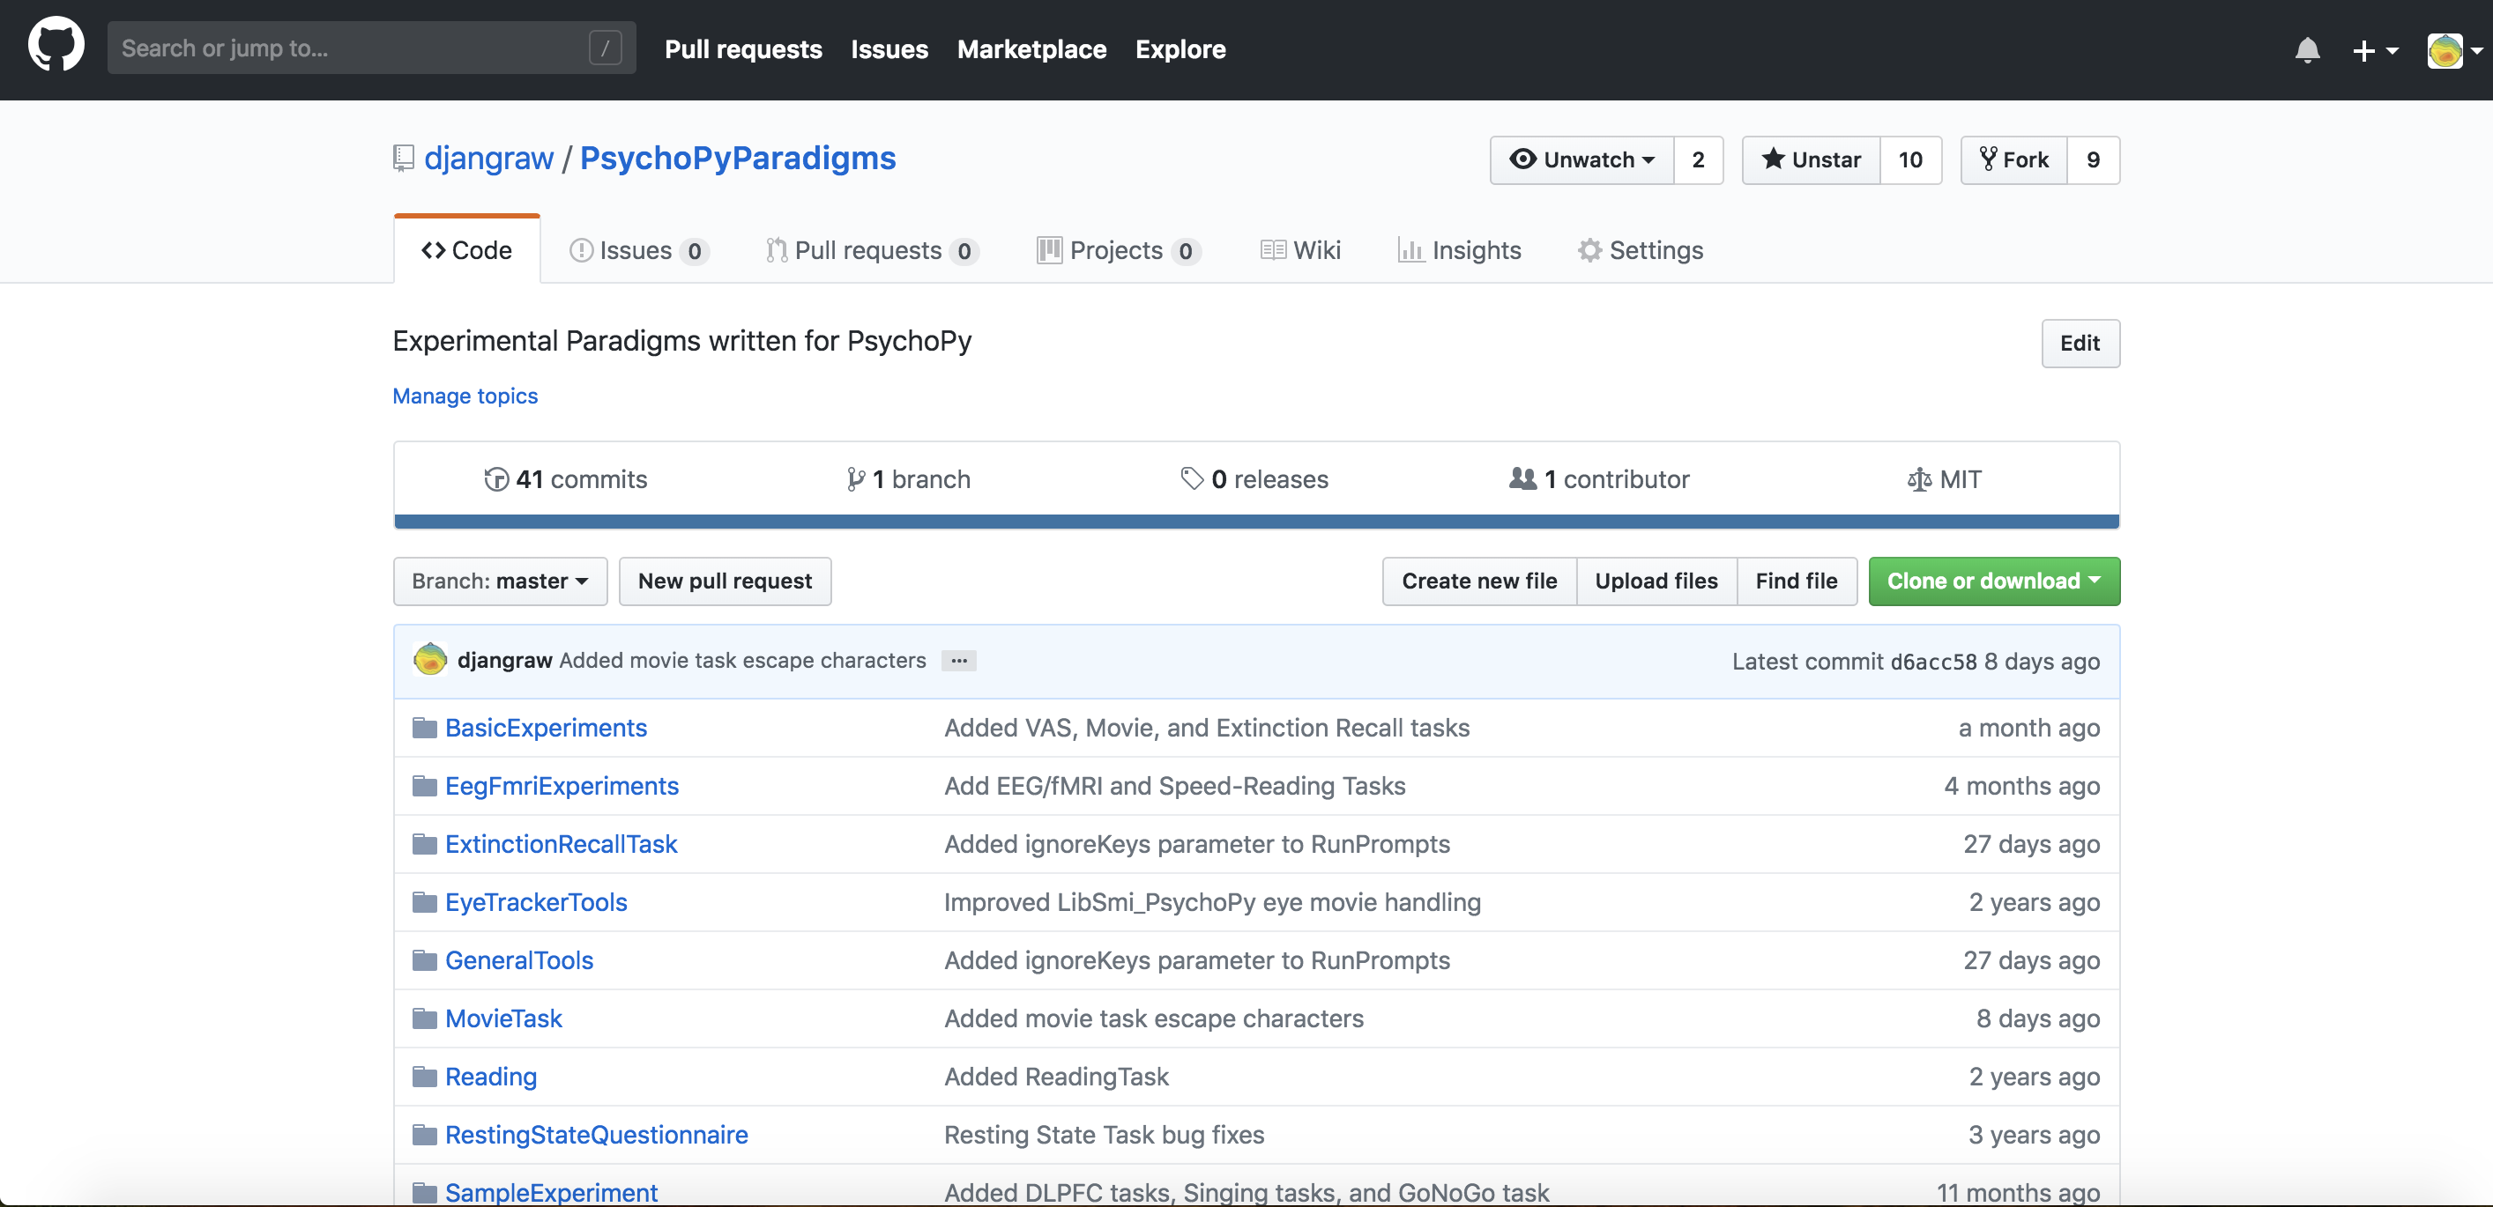
My PsychoPy GitHub Repo
SEARCH
TOOLS
TEMPLATE
https://github.com/djangraw/PsychoPyParadigms
BROWSE

Slide 25
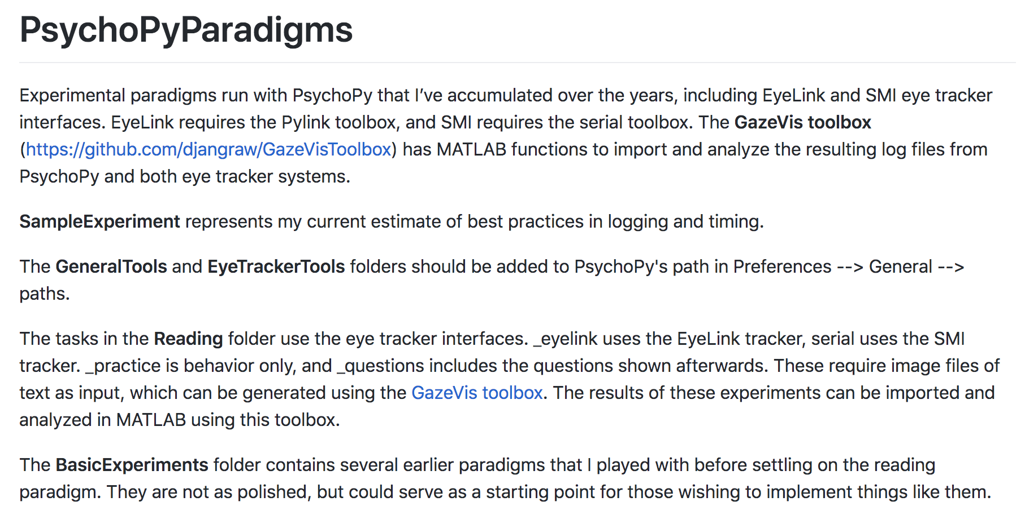
My PsychoPy GitHub Repo
BROWSE

Slide 26
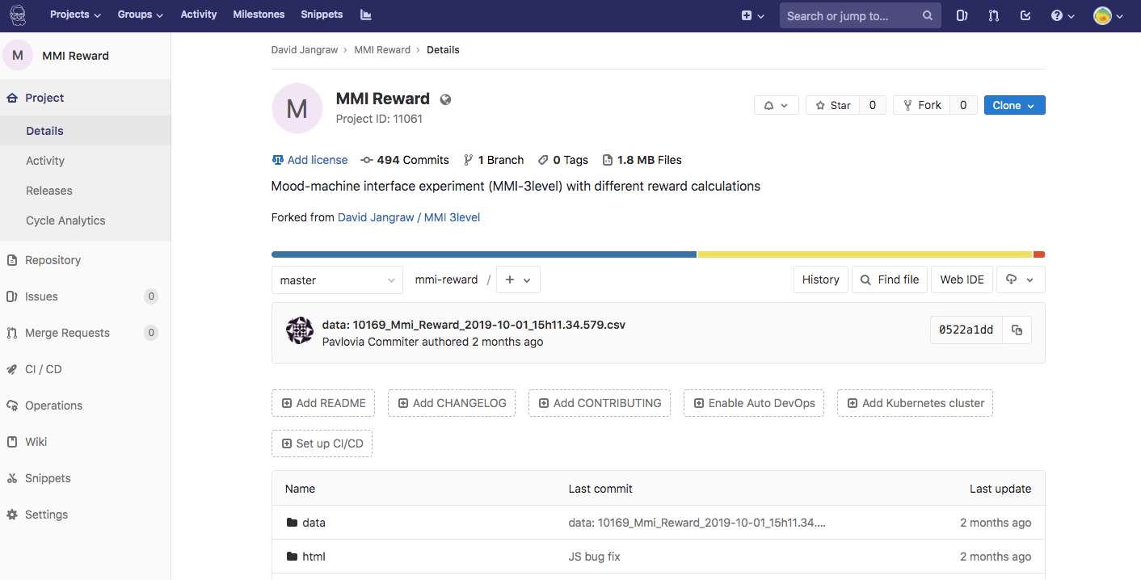
My Pavlovia Repos
Link to my experiments
SEARCH
FORK
CLONE
*.psyexp = PsychoPy Builder File
html/*.js = online experiment

Slide 27
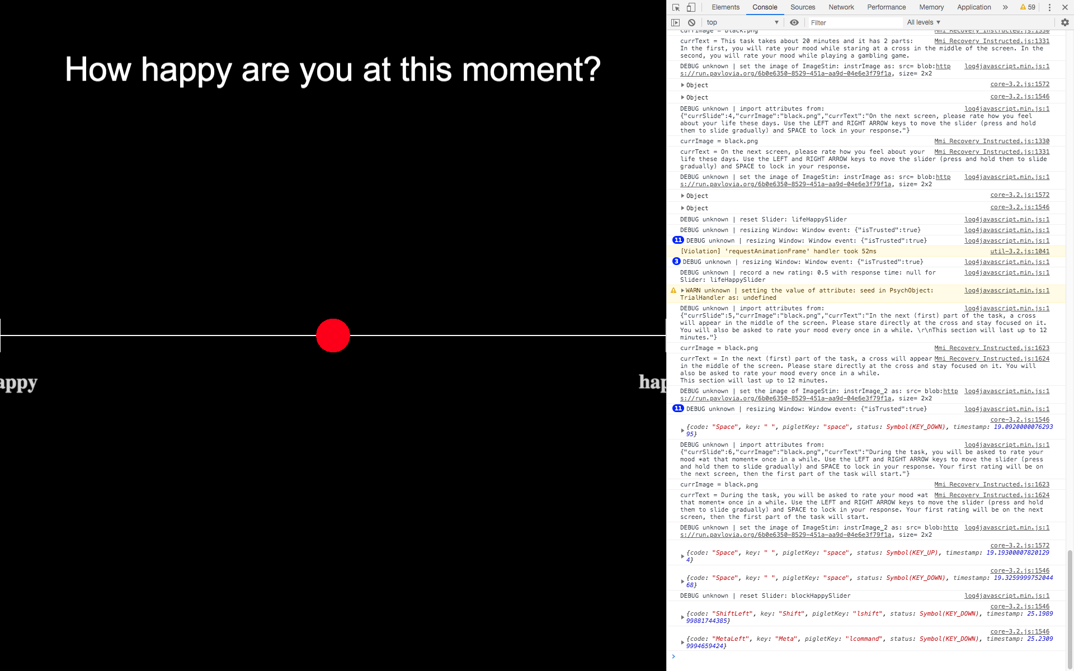
Debugging Online
F12 to see developer tools
Console tab for messages
console.log() to print
Source tab to see code
Refresh your browser’s cache to make changes take hold

Slide 28

Asking Questions
PsychoPy Forum:
https://discourse.psychopy.org/
Python Forums:
StackExchange, StackOverflow, many others
The “forum police” will chastise you if you ask a duplicate question, so google it thoroughly first!
Me, Jen, or any PsychoPy coder
Formal PsychoPy tutorials
Stroop task video by Jon Peirce (creator of PsychoPy) →
Several others with different tasks
Making a simple stimulus in coder
Thanks Jon.

Slide 29
Thanks!

